Slide 1


CS 174A
Discussion-Week 6
2/14/2020

Slide 2
Assignment 3

Slide 3
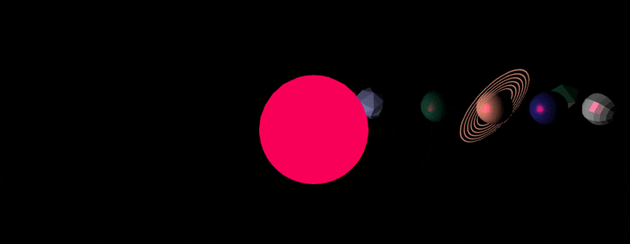
Assignment 3
What’s the final goal ?

Slide 4
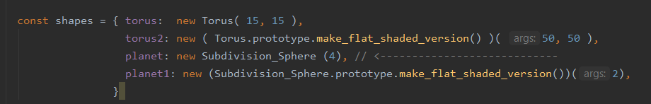
Assignment 3
First, define the shapes according to the specs:
In the constructor of class Assignment_Three_Scene
Note that there are different methods, already implemented, that allow you to satisfy the requirements in the specs

Slide 5
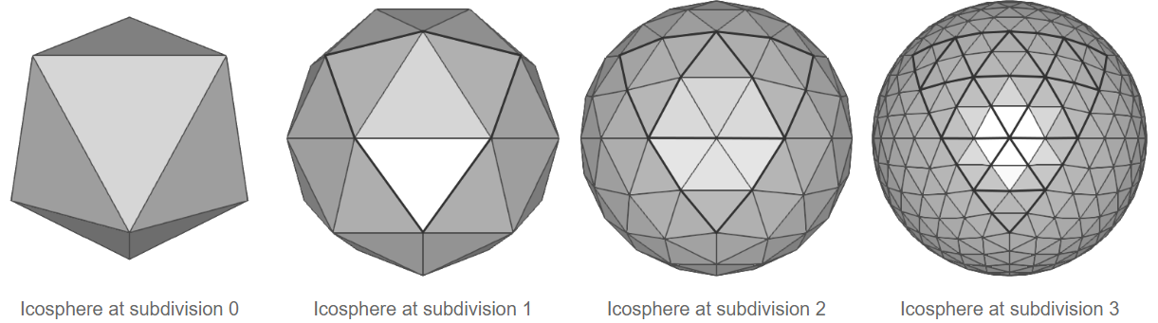
Assignment 3
The Subdivision_Sphere class allows you to build spheres using a set of triangles.
Intuitively, the process starts by a tetrahedron ( or icosahedron) that is subdivided to create the nice and detailed shape of sphere.
http://www.songho.ca/opengl/gl_sphere.html

Slide 6
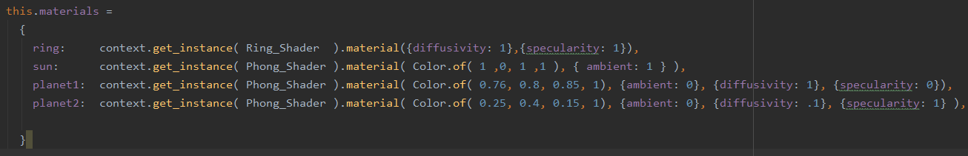
Assignment 3
Now, let’s define the materials, according to the specs, which we will apply to each object

Slide 7
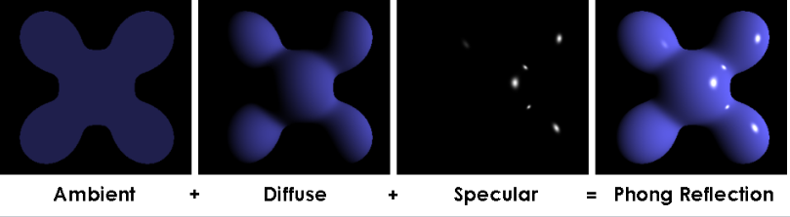
Assignment 3
Note that when defining these different materials, you may need to specify the following:
Shader : e.g. Phong shader : Phong shading calculates the pixel colors according to the interpolated normals and a reflection model
Ambient, diffusivity, specularity
Color

Slide 8
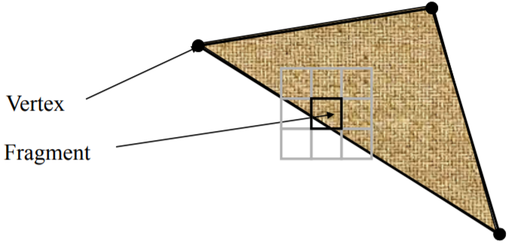
Vertex and Fragment Shaders
Vertex shader : The job of a vertex shader is to transform the vertex position to the screen
Input : Triangle vertex + additional data ( e.g. color )
Output : Vertex with transformed position + normals
Output of vertex shader is then rasterized
Fragment shader: The data inside each triangle is then sent to fragment shader
Input: Data inside each triangle + additional data (e.g. color)
Output: Color + z depth of a fragment ( piece of triangle covered by pixel

Slide 9
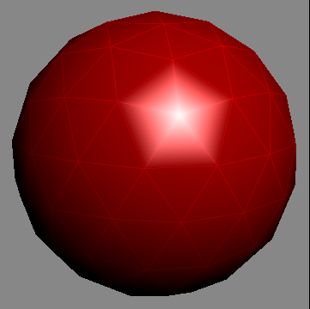
Gouraud and Phong Shading
Gouraud shading:
Calculate the average unit normal vector at each vertex.
Apply an illumination model to each vertex using this normal.
Linearly interpolate the vertex intensities over the surface of the polygon.
One issue with Gouraud shading is it can’t properly handle specular highlights moving smoothly across the object.
By Zom-B, CC BY 2.0, https://commons.wikimedia.org/w/index.php?curid=1556433

Slide 10
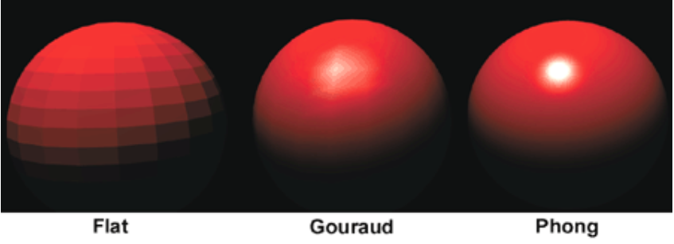
Gouraud and Phong Shading
Phong shading:
Normals are linearly interpolated from the vertex normals
Lighting model is applied to every point using the computed normal.
It requires more calculation and is slower that Gouraud shading.

Slide 11
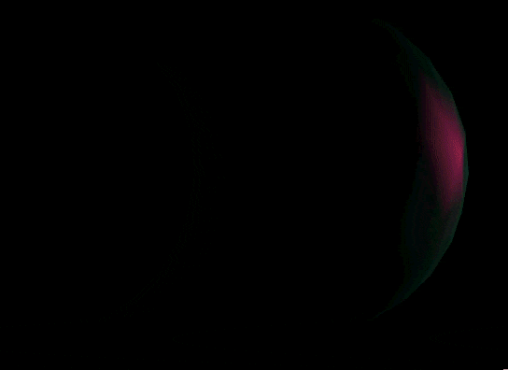
Gouraud and Phong Shading
For Planet 2, apply Gouraud shading in every odd second, but regular smooth shading every even second.
To apply Gouraud shading, in the material object set “ gouraud:1 “ flag.

Slide 12
Creation Different Objects: Sun
Create a spherical sun at the origin
It is subdivided 4 times
It swells from radius 1 up to 3 over a 5 second :
Hint : scale= B+ Sin (At) ( B = 2 ? )
Fades from blue when it's smallest to red when it's biggest.
Blue: (0,0,1,1) Red: (1,0,0,1)
Hint : color= C + D* Sin (At)
Make a point light source located in the center of the sun, matching the current color of the sun ball, with a size parameter equal to 10**n where n is the current sun radius
graphics_state.lights= Light[(Vec.of(0,0,0,1),Color.of(f(color),0,g(color),1),h(scale))]

Slide 13
Creation Different Objects
Place four orbiting planets
Their radii shall all be 1
The smallest orbit shall be 5 units away from the sun
Each orbit after shall be 3 units farther
Each farther planet revolving at a slightly slower rate than the previous

Slide 14
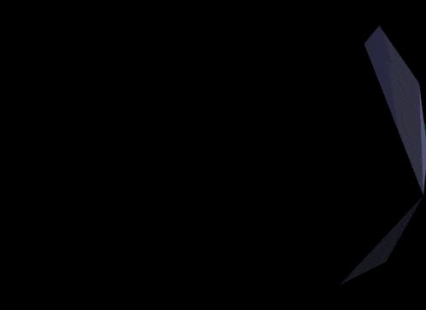
Planet 1: Icy-gray
Icy-gray,
2 subdivisions
flat shaded
diffuse only

Slide 15
Planet 2: Swampy green-blue
Swampy green-blue
3 subdivisions
maximum specular
low diffuse
Apply Gouraud shading to it every odd second, but regular smooth shading every even second

Slide 16
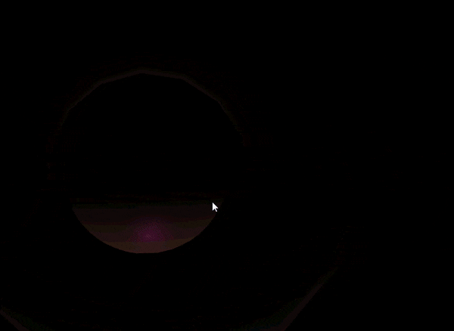
Planet 3: Muddy brown-orange
Muddy brown-orange
4 subdivisions, maximum diffuse and specular
The planet must wobble on in its rotation over time (have an axis not the same as the orbit axis).
The planet must have a ring (torus shape)
The ring and planet must wobble together (base the ring's matrix directly on the planet's matrix).

Slide 17
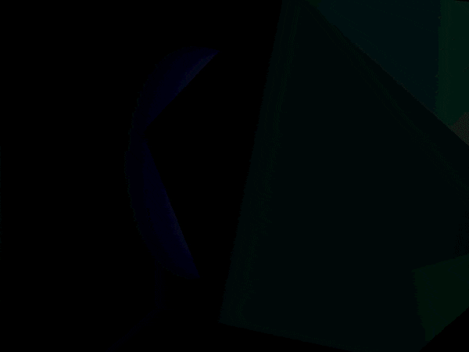
Planet 4: Soft light blue
Soft light blue
4 subdivisions, smooth phong, high specular.
Add a moon for this planet.
The moon has 1 subdivision, with flat shading, any material, and a small orbital distance around the planet.

Slide 18
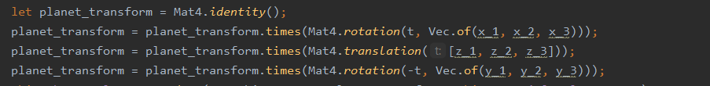
General Movement
Generally the motion of planets can be achieved in a manner similar to the following ( appropriate changes and adjustments need to be taken)
Note: you may need to add additional transformations. This is just to give an idea.

Slide 19
Project

Slide 20
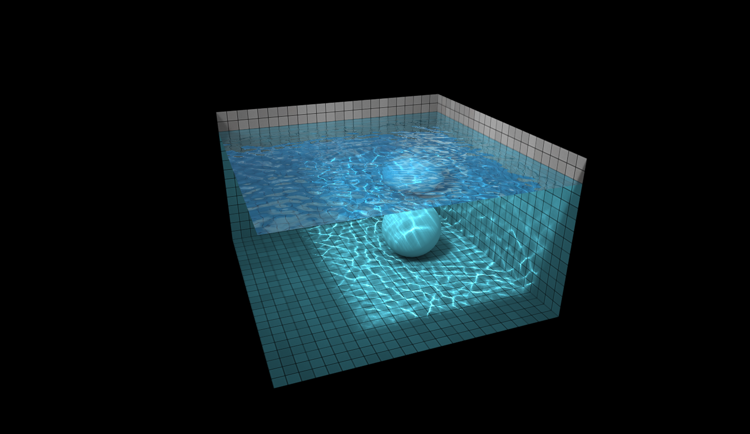
Project
Characteristics of a nice project
Novel techniques
Attractive Scenes
Cool interactions in the game

Slide 21
Project
Novel techniques
Simulate the abstract substance
e.g. water, fog, clouds, smoke
Simplify the complex movements and interactions/ collisions
Check this link for demo: (WebGL Water)
http://madebyevan.com/webgl-water/

Slide 22
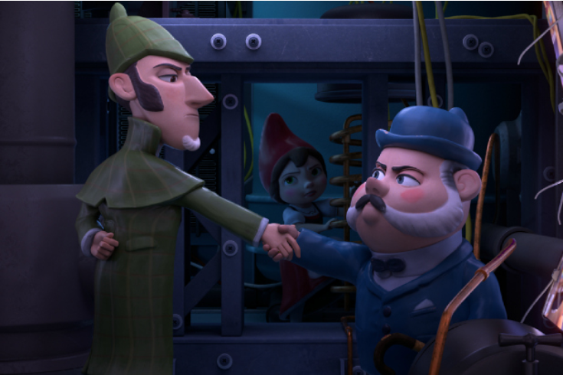
Project
Attractive Scenes
Composition
Color

Slide 23
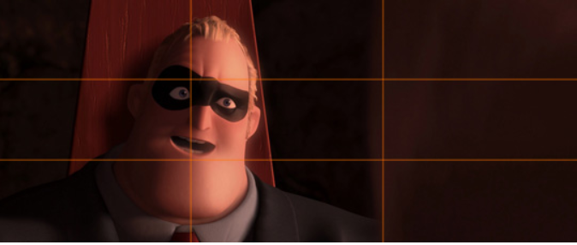
Project
Composition
Rule of Third
Symmetry and Patterns
Appropriate Simplifications

Slide 24
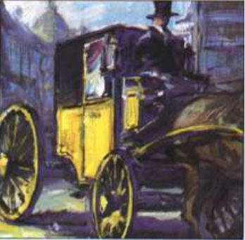
Project
Color
Analogous
Complementary
Monochromatic

Slide 25
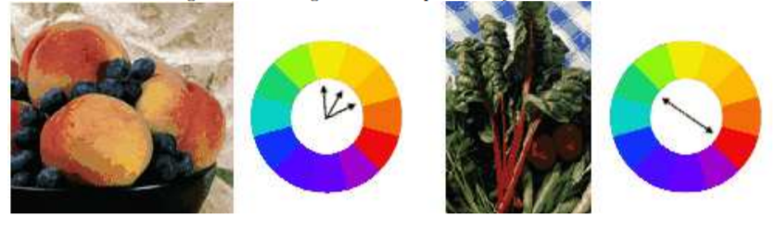
Project
Analogous
Analogous colors are any three colors which are side-by-side on a 12-part color wheel such as green, yellow-green and yellow. This type of color is often found in nature and it tends to be pleasing to the eye

Slide 26
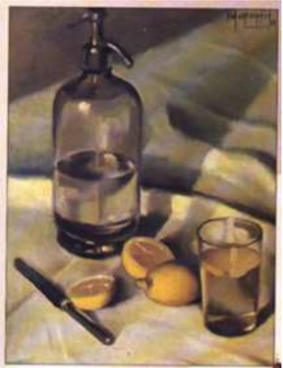
Project
Complementary
Complementary colors are two colors that are directly opposite to each other on the color wheel, such as red and green and orange and blue

Slide 27
Project
Complementary
Complementary colors are two colors that are directly opposite to each other on the color wheel, such as red and green and orange and blue

Slide 28
Thank you!

